Slide 1

IntelliWheels
Intelli
Wheels
AI-Powered Car Marketplace Assistant for Jordan
AI Engineer Course Capstone Project — February 2026
Gemini 2.5
Django REST
Twilio WhatsApp

Slide 2
The Problem
Jordan's car marketplace faces critical challenges that make buying and selling vehicles frustrating, time-consuming, and opaque for consumers.
💰
Price Opacity
🔍
Information Fragmentation
No standardized JOD pricing across platforms. Buyers struggle to determine fair market value, leading to overpayment or undervaluation.
Car data scattered across forums, Facebook groups, and classified sites. No centralized source for specifications, reviews, or comparisons.
Impact: 30-40% price variance
Impact: 15+ sources needed
📷
No Visual Identification
📱
Accessibility Gap
Can't identify cars spotted on the street. No tool to snap a photo and instantly get model, year, specs, and market value.
Existing platforms aren't mobile-friendly. Users need desktop access for full functionality, limiting on-the-go decision making.
Impact: Missed opportunities
Impact: 70% mobile users excluded

Slide 3
The Solution
IntelliWheels combines cutting-edge AI with intuitive design to revolutionize how Jordanians buy, sell, and research vehicles.
🤖
AI Chatbot
📊
Price Estimator
Powered by Gemini 2.5 Flash for intelligent car advice, comparisons, and recommendations in natural Arabic & English.
Crisp depreciation logic covering 15 makes and 70+ models. Accurate JOD valuations based on age, mileage, and market conditions.
Natural Language
Bilingual
Real-time
70+ Models
JOD Pricing
Data-Driven
👁️
Vision Helper
📲
WhatsApp Share
Upload any car photo for instant AI identification. Get model, year, specs, and estimated market value within seconds using computer vision.
Seamless Twilio integration enables users to share listings, price estimates, and car details directly via WhatsApp to friends and family.
Image Recognition
Instant ID
Gemini Vision
Twilio API
One-Click Share
Social Ready

Slide 4
Technology Stack
System Architecture
Core Technologies
Browser
Django REST
Python
3.12
Django
4.2
Chatbot
Crisp Logic
Vision
WhatsApp
Gemini
2.5 Flash
SQLite
Gemini API
google-genai
SDK
Twilio
WhatsApp
SQLite
Database
Security
Performance
Scalability
Django's built-in CSRF, XSS protection, and secure authentication
Async views, caching layers, and optimized database queries
Modular service architecture for easy horizontal scaling

Slide 5
API Design
RESTful Endpoints
/api/estimate/
POST
POST
/api/chat/
AI conversation
// Request
{
"make": "Toyota",
POST
/api/estimate/
Price estimation
"model": "Camry",
"year": 2020,
"mileage": 80000
POST
/api/vision/
Image analysis
}
POST
/api/share/
WhatsApp share
/api/chat/
POST
GET
/api/makes/
List car makes
// Response
GET
/api/models/
List models
{
"response": "The Toyota Camry...",
"session_id": "uuid",
GET
/api/history/
User history
"tokens_used": 245
}
RESTful Design: Standard HTTP methods, JSON responses, proper status codes
Authentication: Token-based API keys

Slide 6
Crisp Price Estimator
Depreciation Formula
Depreciation Tiers
Value = Base Price × (1 − rate)^age − Mileage Penalty
Luxury
12%
Mercedes, BMW, Audi, Lexus — Higher initial depreciation
Base Price: Manufacturer's original MSRP in JOD
Premium
10%
Rate: Annual depreciation percentage by tier
Toyota, Honda, Nissan, Hyundai — Moderate depreciation
Age: Years since manufacture
7%
Economic
Mileage Penalty: JOD 0.005 per km over 15k/year
Kia, Chevrolet, Ford, Suzuki — Lower depreciation
Example Calculation
Vehicle
Year
Mileage
Est. Value
Toyota Camry
2020
80,000 km
16,213 JOD
// Calculation Steps
Base Price = 25,000 JOD // Toyota Camry MSRP
Age = 6 years // 2020 → 2026
Rate = 10% // Premium tier
Mileage Penalty = (80,000 − 90,000) × 0.005 = 0 JOD
Value = 25,000 × (0.9)^6 − 0 = 16,213 JOD

Slide 7
System Architecture
Chat Flow
Price Flow
1
User sends message
1
User submits car details
2
Django validates & stores
2
System validates make/model
3
Gemini API processes
3
Crisp logic calculates value
4
Response returned & logged
4
Estimate stored & returned
Vision Flow
WhatsApp Flow
1
User uploads car image
1
User requests share
2
Image validated & processed
2
System formats message
3
Gemini Vision analyzes
3
Twilio API sends
4
ID + specs + price returned
4
Delivery confirmation
Database Schema
CarListing
ChatSession
ChatMessage
PriceEstimate
VisionAnalysis
• make, model
• session_id
• session (FK)
• car_details
• image_url
• year, price
• user_id
• role, content
• estimated_value
• identified_car
• mileage
• created_at
• timestamp
• created_at
• confidence_score

Slide 8

Demo & Features
Live Demo Flow
Safety Features
1
AI Chat
Input validation
Rate limiting
Ask about any car in Arabic or English
SQL injection protection
XSS prevention
2
Price Estimator
Get instant JOD valuation
3
Vision Helper
Performance
Upload photo for instant ID
< 500ms response
Async processing
4
WhatsApp Share
Share results with friends
Connection pooling
Query optimization
Capstone Requirements
7 RESTful API endpoints
AI integration (Gemini 2.5)
Database with 5+ models
Third-party API (Twilio)

Slide 9
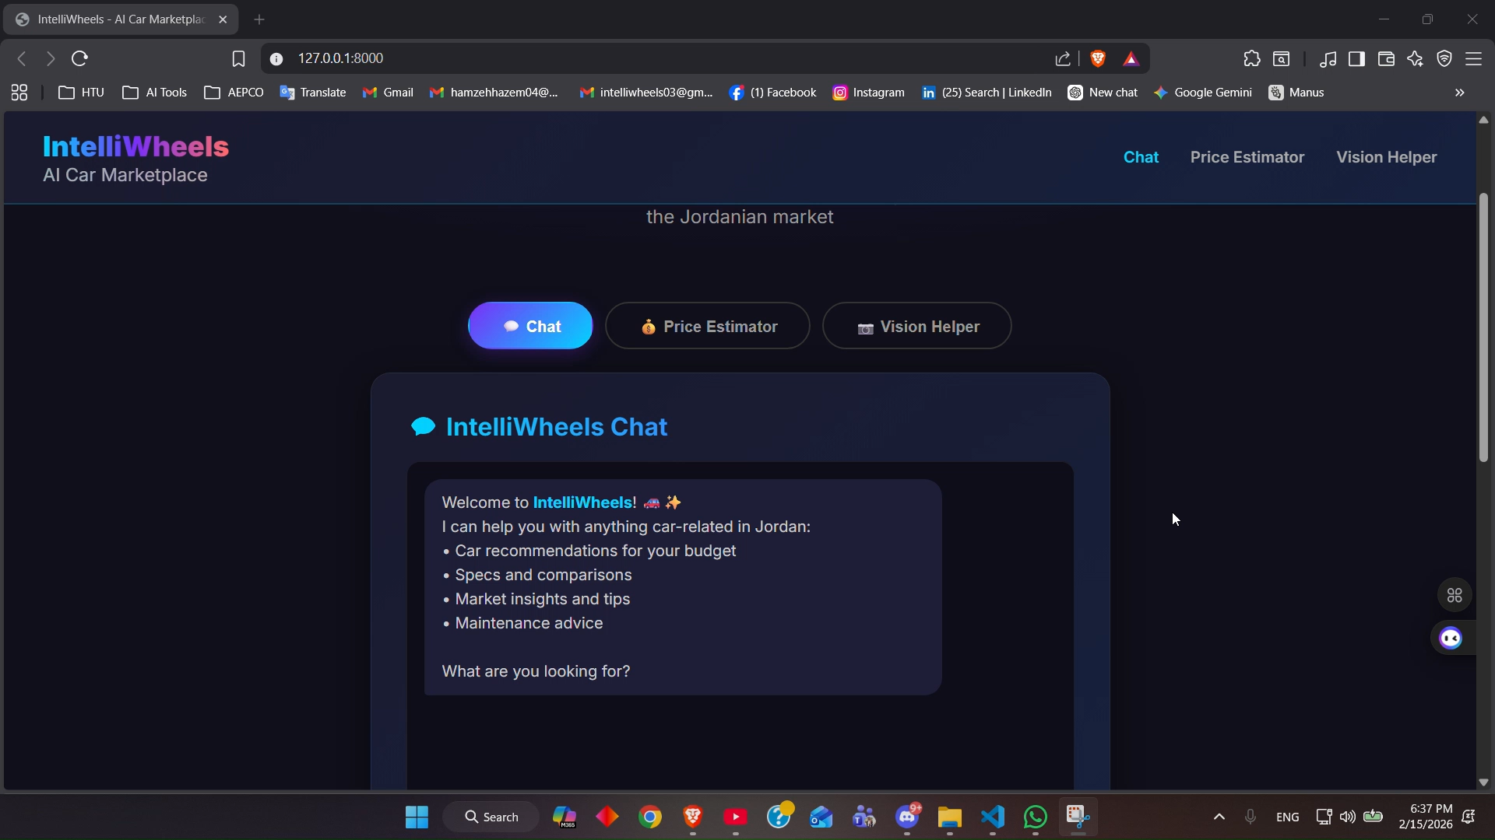
Demo & Features

Slide 10

Thank
You
Questions & Discussion
7
4
5
API Endpoints
AI Features
DB Models
Made by: Hamza Al Jabari
Instructed by: Tala Jazzazi
AI Engineer Course Capstone Project • February 2026

